Slide 1
A Religion that makes sense
Scripture and the Athenasian Creed
John 4:19-26

Slide 2
Extract from the Athenasian Creed
“That we worship one God in Trinity, and Trinity in Unity; Neither confounding the persons, nor dividing the substance. For there is one person of the Father, another of the Son, and another of the Holy Spirit. But the Godhead of the Father, of the Son, and of the Holy Spirit is all one, the glory equal, the majesty co-eternal. Such as the Father is, such is the Son, and such is the Holy Spirit. The Father uncreated, the Son uncreated, and the Holy Spirit uncreated. The Father incomprehensible, the Son incomprehensible, the Holy Spirit incomprehensible. The Father eternal, the Son eternal, and the Holy Spirit eternal. And yet they are not three eternals, but one uncreated and one incomprehensible. So likewise the Father is almighty, the Son almighty, and the Holy Spirit almighty; And yet they are not three almighties, but one almighty. So the Father is God, the Son is God, and the Holy Spirit is God; And yet they are not three Gods, but one God. So likewise the Father is Lord, the Son Lord, and the Holy Spirit Lord; So are we forbidden by the catholic* religion to say: There are three Gods or three Lords. The Father is made of none, neither created nor begotten. The Holy Spirit is of the Father and of the Son; neither made, nor created, nor begotten, but proceeding. So there is one Father, not three Fathers; one Son, not three Sons; one Holy Spirit, not three Holy Spirits. And in this Trinity none is afore, or after another; none is greater, or less than another. But the whole three persons are co-eternal, and co-equal. So that in all things, as aforesaid, the Unity in Trinity and the Trinity in Unity is to be worshipped. He therefore that will be saved must thus think of the Trinity...”
Notes:
I want to start this lecture with something that makes absolutely no sense at all to me.
The Athenasian creed.

Slide 3
What the Creed says
The doctrine of the Trinity states that:
Three beings are one being
Jesus, God and the Holy Spirit are equal
Jesus, God and the Holy Spirit are one Being
Jesus Christ has always existed
Notes:
{READ Slide}

Slide 4
Objectives
Our Objectives are:
To show that these statements according to the Bible are false
To state the simple Truth about God, Jesus Christ and the Holy Spirit
To explain where the Trinity came from
Notes:
{READ Slide}

Slide 5
The Trinity – NOT in the Bible
Notes:
Most assume that the word Trinity is surely found in the Bible.
But even this is not true—the word itself is nowhere in Scripture.
The term and its meaning are a complete invention of deceived men.
With this invention, the universal church has, in fact, been responsible for literally dis-fellowshipping—excommunicating!—the true God of the Bible from the world of supposed Christianity!

Slide 6
Jesus and God the same?
Jesus Christ
Was Tempted (Heb.2:18)
Died (Rev.1:18)
Seen by men
God (the Father)
Cannot be tempted (James 1:13)
Cannot die (1 Timothy 6:16)
Cannot be seen of men (1 Timothy 6:16)
Notes:
Jesus Christ cannot be 'Very God' (the same person) because of these contradictions

Slide 7
Jesus Christs’ Father is his God
Jesus ascended to his Father and his God – John 20:17
“And he happened in these days to go out onto the mountain to pray, and he was continuing all night in prayer to God.” - Lk. 6:12
“So that the God of our Lord Jesus Christ, the Father of glory, may give you a spirit of wisdom and revelation in knowledge of him,” - Eph. 1:17
“Blessed is the God and Father of our Lord Jesus Christ, who begot us again according to his abundant mercy for a living hope by the resurrection of Jesus Christ from the dead” - 1 Peter 1:3

Slide 8
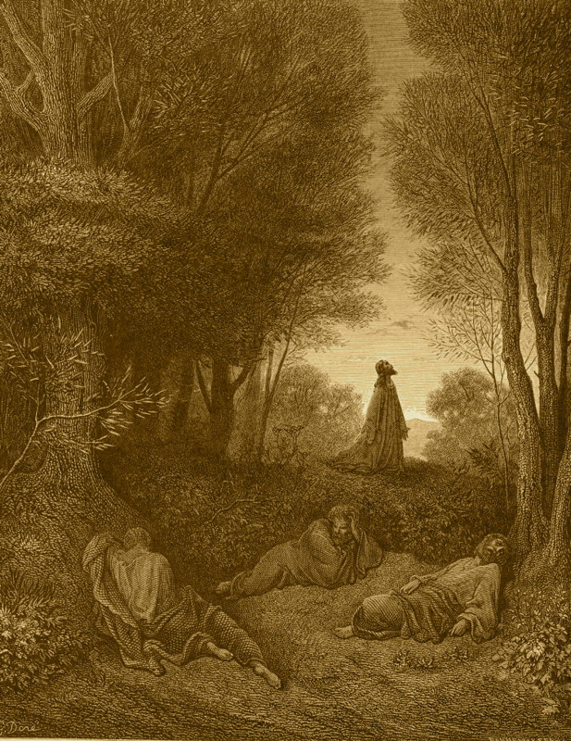
Jesus prayed to his Father
“And having gone forward a little, he fell on his face praying, and saying, My Father, if it be possible, may this cup pass from me. Nevertheless, not as I want, but as thou.” - Matthew 26:39

Slide 9
Jesus is a man
3,291 references tell us Jesus is a man !
These are references after he ascended
“For there is one God, and one mediator between God and men, the man Christ Jesus” - 1 Tim. 2:5
“For we have not an high priest which cannot be touched with the feeling of our infirmities; but was in all points tempted like as we are, yet without sin.” - Heb. 4:15

Slide 10
Jesus is not co-equal with the Father
God is the head of Christ – 1 Cor. 11:3; John 14:28
Christ is approved of God – the greater – Acts 2:22
Christ is subject to the Father – 1 Cor. 15:28
Jesus can do nothing of himself – John 5:19, 30; 7:16
The Father reveals the Revelation to Jesus – Rev. 1:1

Slide 11
We too can be One with God
“Let that therefore abide in you, which ye have heard from the beginning. If that which ye have heard from the beginning shall remain in you, ye also shall continue in the Son, and in the Father.” (1 John 2:24)
“And now I am no more in the world, but these are in the world, and I come to thee. Holy Father, keep through thine own name those whom thou hast given me, that they may be one, as we are...And the glory which thou gavest me I have given them; that they may be one, even as we are one” (John 17:11,22)

Slide 12
Jesus Denied equality with God
“Ye have heard how I said unto you, I go away, and come again unto you. If ye loved me, ye would rejoice, because I said, I go unto the Father: for my Father is greater than I.” (John 14:28)
“And Jesus said unto him, Why callest thou me good? there is none good but one, that is, God.” (Mark 10:18)

Slide 13
Jesus Denied being God
“Then the Jews took up stones again to stone him ... The Jews answered him, saying, For a good work we stone thee not; but for blasphemy; and because that thou, being a man, makest thyself God ... Jesus answered them, Is it not written in your law, I said, Ye are gods? If he called them gods, unto whom the word of God came, and the scripture cannot be broken; Say ye of him, whom the Father hath sanctified, and sent into the world, Thou blasphemest; because I said, I am the Son of God?” (John 10:31-36)

Slide 14
Did Jesus Pre-Exist?
“But when the fullness of the time was come, God sent forth his Son, made of a woman, made under the law” (Galatians 4:4)
“For we have not an high priest which cannot be touched with the feeling of our infirmities; but was in all points tempted like as we are, yet without sin.” (Hebrews 4:15)
Notes:
If Jesus consciously existed in heaven then explain:

Slide 15
Did Jesus Pre-Exist?
“For Moses truly said unto the fathers, A prophet shall the Lord your God raise up unto you of your brethren, like unto me; him shall ye hear in all things whatsoever he shall say unto you.” (Acts 3:22)
“Howbeit that was not first which is spiritual, but that which is natural; and afterward that which is spiritual.” (1 Corinthians 15:46)
“For whom he did foreknow, he also did predestinate to be conformed to the image of his Son, that he might be the firstborn among many brethren.” (Romans 8:29)
Notes:
How an un-dieing being can raise itself out of death?

Slide 16
Clear, Simple, Bible Teaching
The Father is the ONE supreme Being
“There is One God and Father of all, who is above all” (Ephesians 4:6)
The Lord Jesus Christ is God's Son
“Jesus is the Christ, the Son of God” (John 20:31)
The Holy Spirit is Gods Power
“By the power of the Holy Spirit of God” (Romans 15:19)

Slide 17
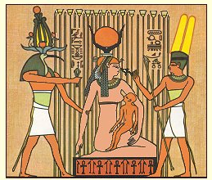
Ancient Roots of Trinity (1)
  (Exploring Ancient History—The First 2500 Years, Schulz, ch. 11, 24).
Notes:
To understand the roots of the Trinity, we turn to the historians
I obtained my knowledge from a book by Schulz
You could readily google this yourself, and find out as much and probably more than I did
In Egypt —about three centuries after the Great Flood of Noah’s time - Three rulers came to be exalted as a triad of deities.
These three—Osiris (Nimrod), Isis (Semiramis) and Horus (the son)

Slide 18
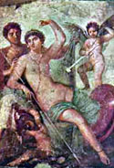
Ancient Roots of Trinity (2)
In Babylon - Ninas, Ishtar and Tammuz.
In ancient Rome - Jupiter, Fortuna and Mercury
The Nicene Council of A.D. 325
(See Encyclopedia Britannica, 11th ed., vol. 6, p. 284)
Notes:
In Babylon, these same three were known as Ninas, Ishtar and Tammuz. With the passage of time, this triad became well-known in many nations.
In ancient Rome, the triad of deities was worshipped as Jupiter, Fortuna and Mercury
The Nicene Council of A.D. 325 was the pivotal event that marked the acceptance of the Pagan belief of Trinities into 'Christianity'.

Slide 19
Origin of Trinity – Counterfeit Church
Revelation 17:5
“Mystery Babylon the great, the mother of harlots and abominations of the earth.”
Notes:
The teaching of the triune god comes from the great false universal religion, described in Revelation 17:5 as “Mystery Babylon the great, the mother of harlots and abominations of the earth.”
This “woman church” has used the trinity to infiltrate and deceive all of traditional Christianity.
Originally introduced with much controversy, she has been able to successfully use this doctrine to hide the truth

Slide 20
Origin of Trinity – Counterfeit Church
Part of this seduction has been then to necessarily introduce “another Jesus” (2 Cor. 11:3-4)
Who becomes the centerpiece of “another gospel” (same passage), taught as a replacement of the true gospel of Jesus Christ, which is the kingdom of God.
All of this deception in turn is derived from and has been driven by “another spirit” (also same passage)
that of the god of this world—active throughout this world’s “churchianity” in the form of the counterfeit trinity god.
The kingdom of God—Christ’s message—offers the only real future for a world otherwise without hope.
Notes:
{2 Cor. 11:3-4}

Slide 21
True Religion
Religion is NOT something that normal people CANNOT understand
“Pure religion and undefiled before God and the Father is this, To visit the fatherless and widows in their affliction, and to keep himself unspotted from the world.” (James 1:27)

Slide 22
Conclusions
The Athenasian Creed is unscriptural
The Trinity is not found in the Bible
God the Father exceeds His Son
Jesus Christ is the Son of God
The Holy Spirit is Gods Power
The Origins of the Trinity is Babel
True religion is simple to Understand
All we have to do is live it ... that's a bit more difficult
Notes:
Jesus said: Salvation is of the Jews
John 4:22-23 – Show me a Jew that believes in a Trinity

